Slide 1
What is the difference between “==“ operator and “equals()” method
momedaram

Slide 2
In general
== operator is used for reference/address compression.
equals() method is used for content compression.

Slide 3

String s1 = new String(“momedaram”);
String s2 = new String(“momedaram”);
System.out.println(s1 == s2);
System.out.println(s1.equals(s2));
momedaram
s1
momedaram
s2

Slide 4
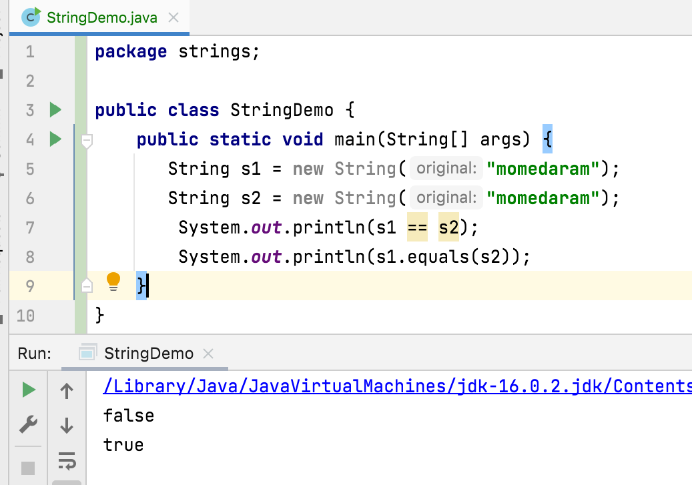

Slide 5
Default version of equals() of object class is used for reference comparison only. Based on our requirement we can override for content comparison.
Note: In String Class , All Wrapper classes and All Collection classes equals() is overridden for content comparison.

Slide 6
Thank You !
momedaram

